Slide 1

Maze
Team Seven – Saul Vassallo, Nick Gaerty, Luca D’Ascari

Slide 2
Overview
3 Main Parts:
- Infrared readings
- Maze traversal algorithm
Wall following implementation

Slide 3
Infrared Readings
The infrared sensor was used to calculate the readings of the maze tiles, start space and end space.
Thresholds were then given to each tile based by comparing the different readings and getting the upper and lower range of each different space.

Slide 4
Thresholds
White maze tiles:
Grey start square:
Black end square:

Slide 5
Maze Traversal Algorithm
Our traversal method utilizes both right and left-hand on wall algorithms.
The robot will start off by constantly following the right wall until it finds the end square. It will make use of the thresholds for this.
Once the end goal is found, it will carry on until it does a full loop around the maze until it gets back to the start square.

Slide 6
Continued…
Once the start square is found, it will then start again in the opposite direction, but this time by following the left wall instead.
This will eliminate the 50/50 chance that the left route is faster than the right.
This will guarantee that the maze is completed by the robot as the start and end goals can both be found on the perimeter of the maze.

Slide 7
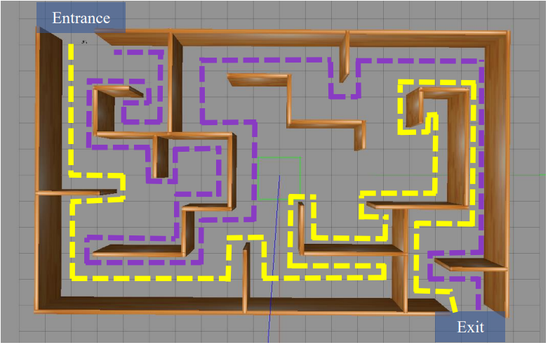
Traversal Visualization

Slide 8
Wall Following Implementation
A dynamic wall following implementation was done.
To start, the robot is given a base speed of 100 and constantly measures the distance to the right wall and maintains a target distance of __cm.

Slide 9
Continued…
Once the measured distance is found, the error is calculated by determining whether it is under or over the target distance.
This error is then multiplied by a scalar value.
The max distance which can be sent is limited to 25 to ensure calibrations remain stable.

Slide 10
Continued…
The speed adjustment is then achieved by multiplying the error by the scalar value, which is then added or subtracted to the base speeds of the right and left motors.
This adjustment is constrained between 0 and 150 to ensure that the speeds will not go beyond these values.

Slide 11
Continued…
A set time was implemented where the robot will stop and use the Ultrasonic Sensor to scan in front of it and check for walls ahead.
If a wall is below the given distance, and there is also a wall on the right, the robot will perform a 90 degree turn and continue.

